Slide 1


Signs and Symptoms
of Allergies
Prepared by Group B

Slide 2

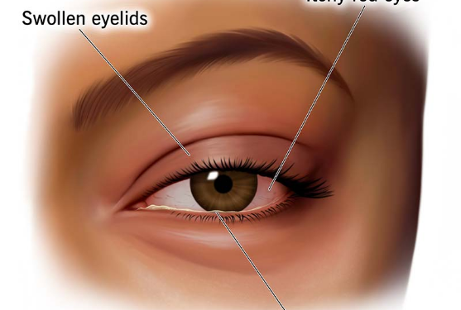
Inhaled Allergens & Airway Contact
Some allergens such as dust or pollen are airborne particles. Symptoms arise directly in areas in contact with air (eyes, nose, and lungs):
Irritation of nose and sneezing
Coughing and wheezing
Red and watery eyes
Increased production of mucus in the lungs
Shortness of breath, etc.

Slide 3


Food Allergy Signs & Digestive Tract
Core Digestive Symptoms
Key Textbook Note
Apart from airborne allergens, allergic reactions result from foods. Symptoms include:
"Food allergies rarely cause respiratory (asthmatic) reactions."
Abdominal pain & bloating
Their primary manifestations remain localized to the digestive tract and visible cutaneous reactions (itching, hives, and skin swelling).
Vomiting & diarrhoea
Itchy skin & swelling of the skin

Slide 4


Food & Drug Allergen Triggers
1. Specific Food Allergens
4. Drug Allergens
Milk: Vomiting, hives.
Penicillin: Diarrhoea, nausea, hives.
Wheat: Stomach upset, eczema, asthma-like symptoms (bronchospasms).
Aspirin: Can induce sudden severe reactions.
Systemic Risk: Certain medicines produce a rapid, whole-body response.
Sea-food: Vomiting, anaphylaxis (in severe cases).
Nuts: Vomiting, red rashes on skin, itching.

Slide 5






Seasonal & Dust Allergies
Spring & Summer
Winter Pollutants
3. Dust Allergy
Spring Pollen: As flowers blossom; causes sneezing and sniffling.
Allergens: Sulphur dioxide, nitrogen dioxide (smog in northern Indian cities).
Allergen: Dust particles.
Main Symptom: Asthma (bronchial irritation & breathing difficulty).
Summer Pollen: Allergic reaction persists throughout warm months due to high pollen sensitivity.
Symptoms: Coughing, itchy eyes & nose, sneezing, running nose, watery eyes.

Slide 6

Insect Bites & Medication Triggers
Allergen Triggers
Clinical Precaution
Allergic reactions can also result from insect bites, reactions to medications like aspirin, and antibiotics such as penicillin.
Because these drugs can provoke severe systemic allergic reactions:
"Therefore, before administering these medications, a doctor or a nurse asks the patient if he/she is allergic to any of them."
These allergens can produce a rapid, whole-body systemic allergic response called anaphylaxis.

Slide 7



Anaphylaxis: Multi-Organ Systems
During anaphylaxis, multiple organ systems can be affected simultaneously. This reaction can be triggered suddenly, or the onset can be delayed.
Digestive System
Respiratory System
Circulatory System
Gastrointestinal disruption including abdominal cramps, nausea, vomiting, and diarrhoea.
Broncho-constriction, severe wheezing, airway narrowing, and shortness of breath.
Low blood pressure (hypotension), vascular dilation, and systemic circulatory shock.

Slide 8
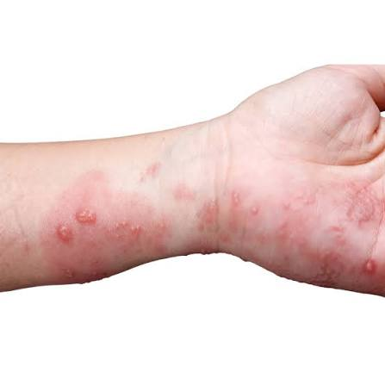
Visible Dermatological Signs
The textbook illustrates distinct cutaneous responses during allergic reactions:
(a) Reddened skin: Localized inflammatory redness and erythema on limbs or body surface.
(b) Skin rash: Eruptive rashes, eczema, hives, and itchy bumps across the neck and chest.
Swelling & Inflammation: Tissue edema affecting hands, face, or general body skin.

Slide 9


Rate of Severity in Anaphylaxis
Severity Indicators from Textbook
Depending on the rate of severity, anaphylaxis causes:
>10 cm
Local skin reactions: Area of skin redness greater than 10 cm in size
Rashes or swelling and inflammation within the skin
AREA OF SKIN REDNESS
Broncho-constriction in the airway
Low blood pressure in the circulatory system

Slide 10
Summary & Review
Key Takeaways on Allergy Signs & Symptoms
Allergens (inhalants, foods, seasonal factors, dust, drugs, and insect bites) manifest in varying severity—from localized respiratory and gastrointestinal distress to acute multi-organ anaphylaxis.

